Slide 1


Phishing Awareness Training
Presented by Muhammad Azhar

Slide 2

Understanding Phishing Attacks
Phishing is a social engineering attack aimed at stealing sensitive data like credentials and money. Attackers typically impersonate trusted sources, creating a facade to manipulate victims into giving up valuable information.

Slide 3
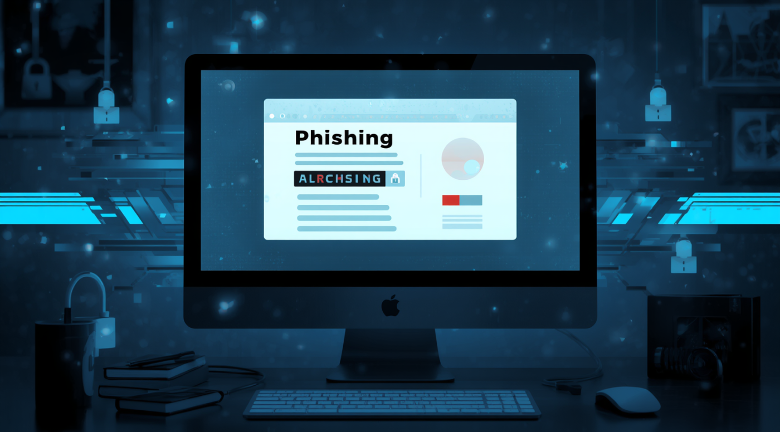
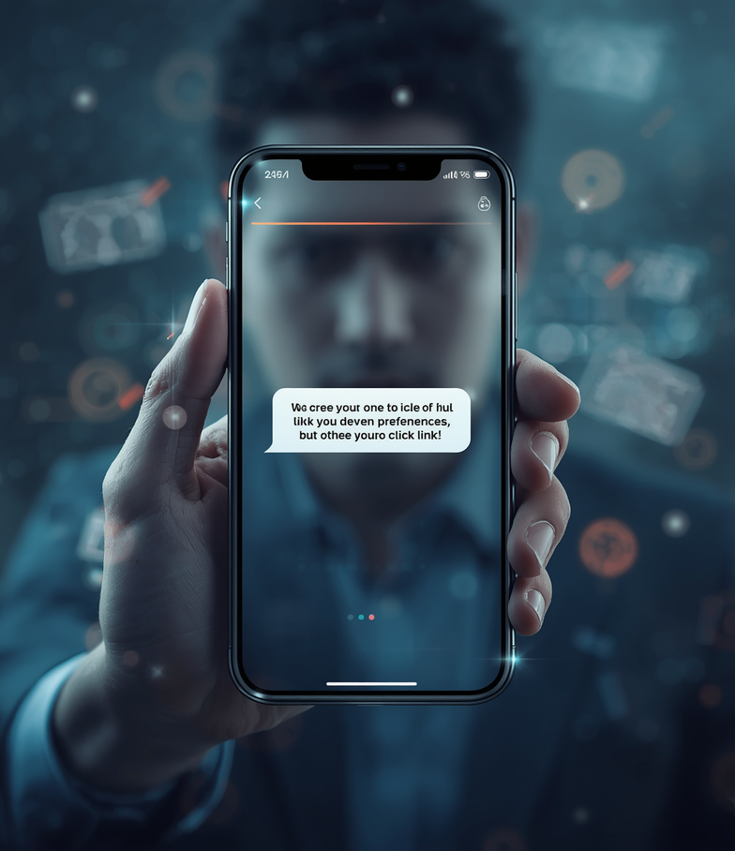
Types of Phishing Attacks Explained

Slide 4

Social Engineering Tactics
Manipulation Methods Used by Attackers
Urgency
Authority
Curiosity
Attackers create a sense of urgency, urging victims to act quickly. This tactic often involves claims like “your account will be suspended” if immediate action is not taken.
Impersonating authority figures, such as banks or government officials, attackers exploit trust. Victims are more likely to comply when they believe they are dealing with a legitimate source.
Curiosity is used to bait victims with enticing offers, such as winning a lottery or receiving a free gift. This tactic prompts individuals to click on malicious links or provide information.
4

Slide 5
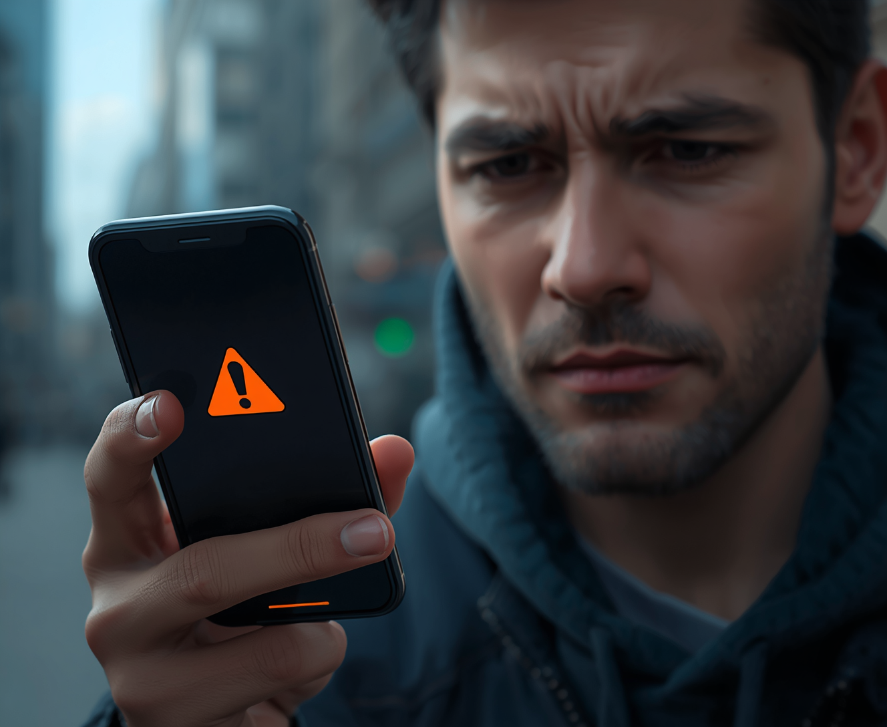
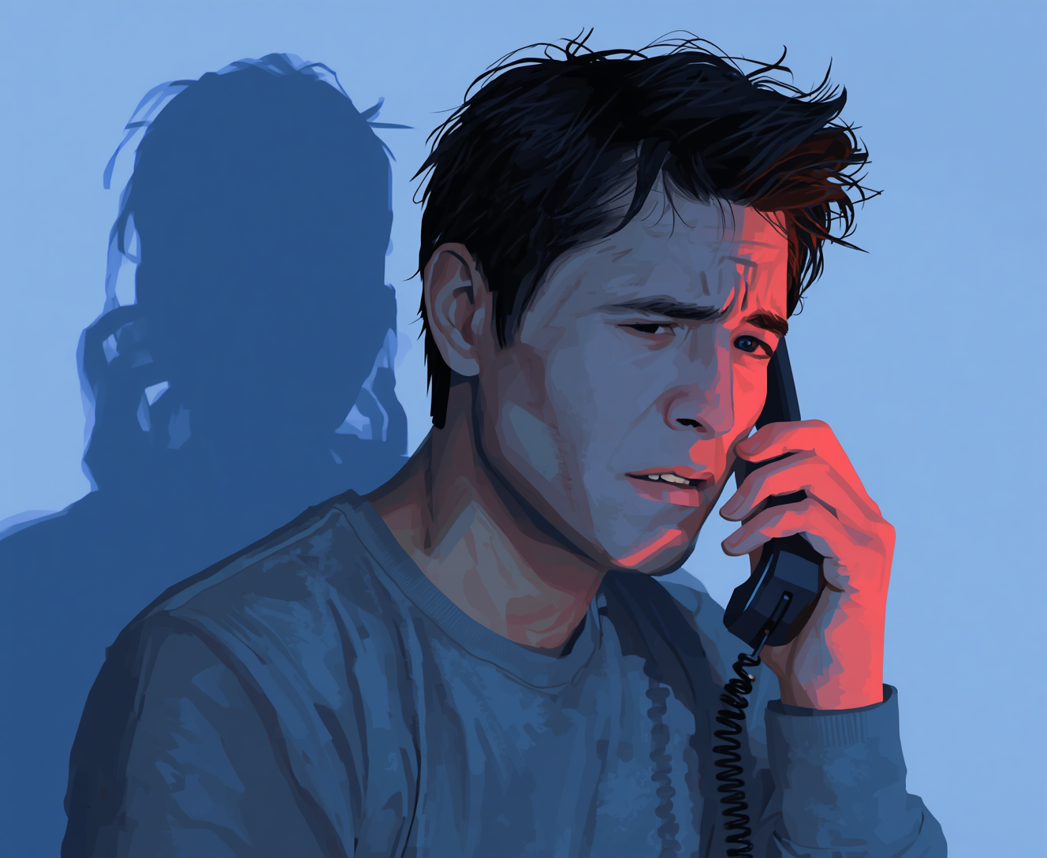
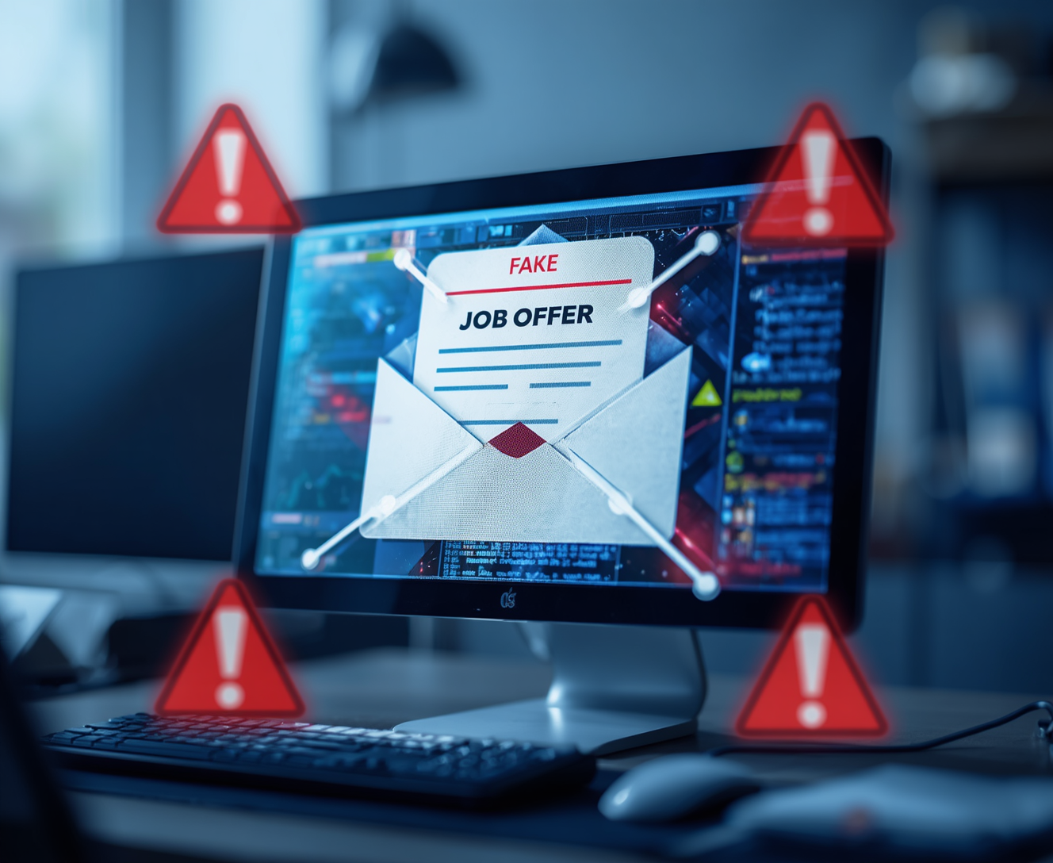
Real World Phishing Examples
Recognizing Threats in Pakistan
Awareness of local phishing tactics is crucial. Examples include fake SMS messages, fraudulent bank calls, and deceptive job offers targeting unsuspecting individuals.
5

Slide 6
Warning Signs of Phishing
01
Suspicious Senders
04
Urgent Language
Check for misspelled email addresses or domains.
Phishing emails often create a false sense of urgency.
02
Unexpected Links
05
Poor Grammar
Hover over links to reveal their true destinations.
Look for obvious spelling or grammatical mistakes.
03
Generic Greetings
Phishing attempts usually lack personalized salutations.

Slide 7
Best Practices to Avoid Phishing
01
Share OTP
04
Verify Sources
Never share your OTP with anyone.
Always confirm the sender through official channels.
02
05
Report Suspicious
Enable 2FA
Report any suspicious messages immediately to IT.
Use two-factor authentication for added security.
03
Check Links
06
Stay Informed
Hover over links to verify the URL before clicking.
Regularly update your knowledge about phishing tactics.

Slide 8
Quiz: Is This Phishing?
Is this a phishing attempt?
Yes, it is
No, it isn't
Unsure
Test your awareness with these three scenarios. Identify which messages may be phishing attempts to enhance your cyber safety knowledge.
Maybe

Slide 9


Cybersecurity Awareness
Stay Smart, Stay Secure Online

